Slide 1
DIVISION OF GLOBAL HIV & TB
Expansion of HIV pre-exposure prophylaxis (PrEP) among key populations in PEPFAR global
program: data from the 1st year of implementation
Gaston Djomand, Trista Bingham, Irene Benech, Tisha Wheeler, Annie Sanicki, Sasha Mital

Slide 2
Background and Methods
Oral PrEP significantly reduces the risk of HIV infection among HIV-negative persons with substantial risk behavior
PEPFAR issued guidance to implement PrEP programming in 2016*
Program data on the number of people newly enrolled on oral PrEP are reported quarterly by PEPFAR’s 36 country/regional programs (countries):
For each quarter, the reported numbers are stratified by general population (GP) and key populations (KPs).
We computed the proportion of all new PrEP enrollees contributed by KP versus GP and compared the relative percentage change in PrEP enrollment for those populations between the 1st and 4th quarters of the implementation year
* PEPFAR Technical Considerations for COP/ROP 2016 :https://www.pepfar.gov/documents/organization/252263.pdf h:

Slide 3
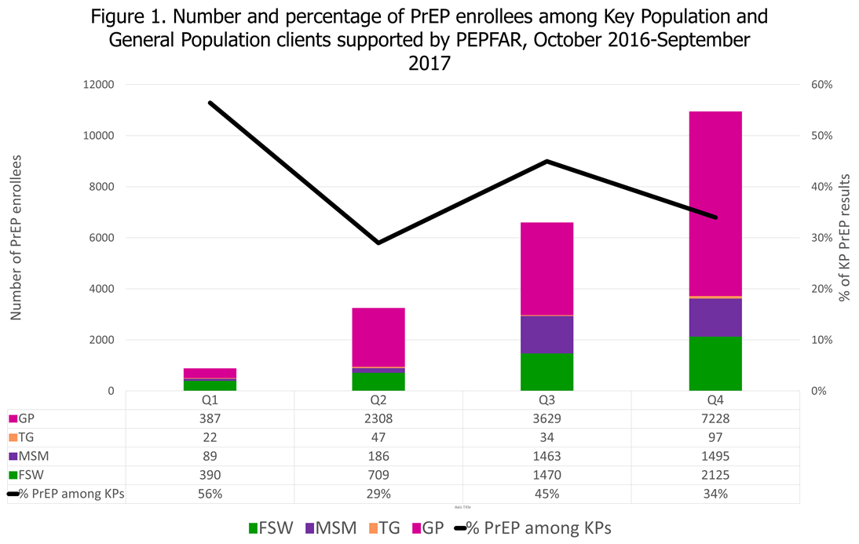
Results
Table: Countries Reporting New PrEP by KP and GP
 | 1rst Quarter | 2nd quarter | 3rd Quarter | 4th Quarter
Countries with new KP PrEP enrollees | 3 | 5 | 8 | 6
Countries with new Prep enrollees | 5 | 7 | 13 | 9

Slide 4
Conclusions and Next Steps
Over the 4 reporting periods in the 1st year of implementation, PrEP enrollment increased steadily among both KP and GP
Reported uptake was higher among GP than KP, although data were not queried for potential misclassification
Specific efforts are needed to streamline KP PrEP scale-up by:
Ensuring accurate reporting and data quality
Increased demand creation beyond early adopters
Advocacy with host country governments to fast-track PrEP services
Next Steps
Identify most successful PrEP implementers
Share country successes and best practices across PEPFAR
Ensure adherence and retention among PrEP users at substantial risk of HIV infection
Continue to advocate for KP enabling environment to address restrictive KP national policies and potential gender inequalities

